Slide 1
FPGA-Based Turing Machine Emulator for Educational Purposes
P. Venkata Sivakumar (192210057)
Roshan (192210282)

Slide 2
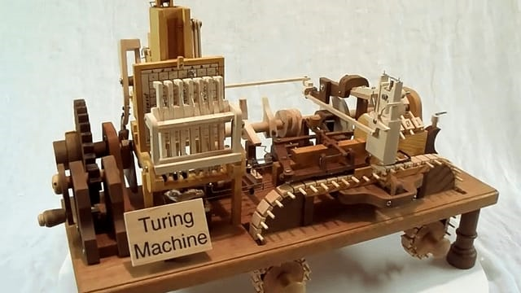
Introduction :
What is a Turing Machine?
- An abstract model of computation, introduced by Alan Turing
- Consists of a tape, head, and set of rules
Why Turing Machines?
- Foundation of theoretical computer science
- Models the concept of algorithm and computation

Slide 3
Importance :
Why Learn Turing Machines?
- Helps understand computability, complexity, and algorithm theory
- *Challenges in Learning*
- Abstract and complex, making it hard to visualize
- Need for practical tools to aid comprehension

Slide 4
Objective :
*Goal*: Develop an FPGA-based Turing machine emulator
*Purpose*: Simulate various configurations of Turing machines
*Educational Benefit*: Allows students to visualize and experiment with Turing machine operations

Slide 5
Advantages :
Real-time processing and parallel computation
- Flexibility to design custom architectures
- Low-level control for precise emulation of Turing machine operations
- *Comparison with Software Emulators*:
- Hardware-based approach offers better performance for complex simulations

Slide 6
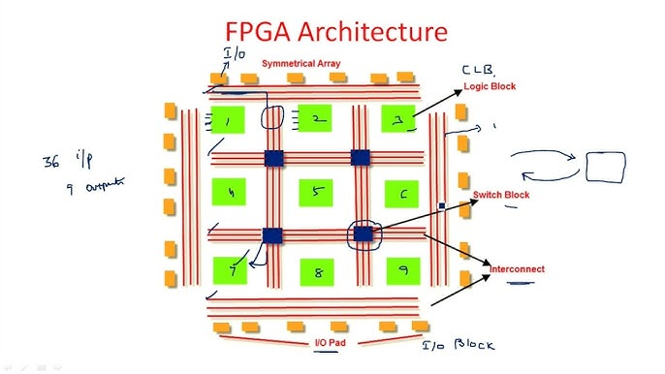
Architecture :
- Tape memory (represents the infinite tape)
- Control unit (simulates the state transitions)
- Read/Write head (interacts with the tape)
- *Implementation Language*: Verilog/VHDL
- *Types of Turing Machines*:
- Deterministic Turing Machine (DTM)
- Non-Deterministic Turing Machine (NDTM)
- Multi-tape Turing Machine

Slide 7
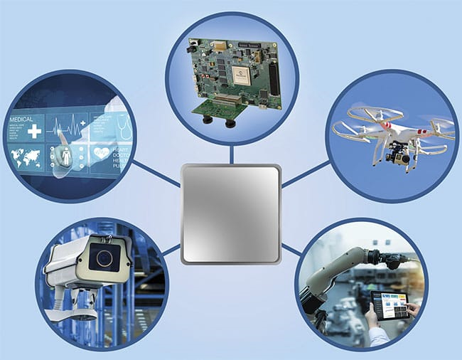
Potential Applications :
*Educational Use*: Ideal for computer science and engineering students
- *Research Tool*: Analyze and simulate different Turing machine configurations
- *Extension Possibilities*: Expanding to emulate multi-tape or non-deterministic Turing machines

Slide 8
Conclusion :
FPGA-based Turing machine emulator as an educational tool. Provides hands-on learning for students studying computation theory .Expandable platform for advanced configurations and research.

Slide 9


